Slide 1



Noida Institute of Engineering and Technology, Greater Noida
INTRODUCTION TO MACHINE LEARNING TECHNIQUES
Unit: 1
Machine Learning Techniques
(ACSML0401 )
Alisha Sikri
Assistant Professor
AIML
B Tech 4th Sem

Slide 2


Faculty Profile
Noida Institute of Engineering and Technology, Greater Noida
Name: Alisha Sikri
Qualification: PhD (Pursuing)
Specialization Areas: Machine Learning, Artificial Intelligence
COURSE | BOARD/UNIVERSITY | YEAR OF PASSING
PhD | SRM University, NCR | Pursuing
M.Tech | DCRUST University, Murthal | 2016
B.Tech | MDU, Rohtak | 2014

Slide 3
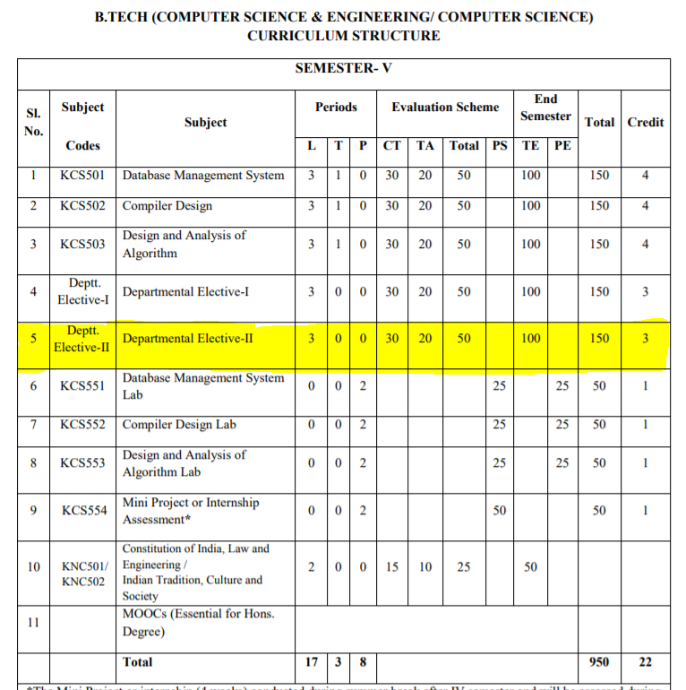
Evaluation Scheme

Slide 4
Syllabus
Unit-I : Introduction-
Learning, Types of Learning, Well defined learning problems, Designing a Learning System, History of ML, Introduction of Machine Learning Approaches – (Artificial Neural Network, Clustering, Reinforcement Learning, Decision Tree Learning, Bayesian networks, Support Vector Machine, Genetic Algorithm), Issues in Machine Learning and Data Science Vs Machine Learning
Unit-II : REGRESSION:
Linear Regression and Logistic Regression BAYESIAN LEARNING - Bayes theorem, Concept learning, Bayes Optimal Classifier, Naïve Bayes classifier, Bayesian belief networks, EM algorithm. SUPPORT VECTOR MACHINE: Introduction, Types of support vector kernel – (Linear kernel, polynomial kernel,and Gaussiankernel), Hyperplane – (Decision surface), Properties of SVM, and Issues in SVM.
Unit-III : DECISION TREE LEARNING - Decision tree learning algorithm, Inductive bias, Inductive inference with decision trees, Entropy and information theory, Information gain, ID-3 Algorithm, Issues in Decision tree learning. INSTANCE-BASED LEARNING – k-Nearest Neighbour Learning, Locally Weighted Regression, Radial basis function networks, Case-based learning.

Slide 5
Syllabus
Unit-IV : ARTIFICIAL NEURAL NETWORKS –
Perceptron’s, Multilayer perceptron, Gradient descent and the Delta rule, Multilayer networks, Derivation of Backpropagation Algorithm, Generalization, Unsupervised Learning – SOM Algorithm and its variant; DEEP LEARNING - Introduction,concept of convolutional neural network , Types of layers – (Convolutional Layers , Activation function , pooling , fully connected) , Concept of Convolution (1D and 2D) layers, Training of network, Case study of CNN for eg on Diabetic Retinopathy, Building a smart speaker, Self-deriving car etc..
Unit-V : REINFORCEMENT LEARNING–Introduction to Reinforcement Learning , Learning Task,Example of Reinforcement Learning in Practice, Learning Models for Reinforcement – (Markov Decision process , Q Learning - Q Learning function, Q Learning Algorithm ), Application of Reinforcement Learning,Introduction to Deep Q Learning. GENETIC ALGORITHMS: Introduction, Components, GA cycle of reproduction, Crossover, Mutation, Genetic Programming, Models of Evolution and Learning, Applications

Slide 6
Branch wise Application
Virtual Personal Assistants
Predictions while Commuting
Videos Surveillance
Social Media Services
Email Spam and Malware Filtering
Online Customer Support
Search Engine Result Refining
Product Recommendations
Online Fraud Detection

Slide 7
Course Objectives
This course will serve as a comprehensive introduction to various topics in machine learning
To introduce students to the basic concepts and techniques of Machine Learning.
To become familiar with regression methods, classification methods, clustering methods.
To introduce the concept of Decision Tree Learning and Instance-based Learning
To become familiar with Artificial Neural Networks and Deep Learning
To introduce the concept of Reinforcement Learning and Genetic Algorithms

Slide 8
Course Outcomes
At the end of the course, the student should be able to
COURSE OUTCOME NO | COURSE OUTCOMES
CO1 | To understand the need for machine learning for various problem solving
CO2 | To understand a wide variety of learning algorithms and how to evaluate models generated from data
CO3 | To understand the latest trends in machine learning
CO4 | To design appropriate machine learning algorithms and apply the algorithms to a real-world problems
CO5 | To optimize the models learned and report on the expected accuracy that can be achieved by applying the models

Slide 9
Program outcomes
1. Engineering knowledge
2. Problem analysis
3. Design/development of solutions
4. Conduct investigations of complex problems
5. Modern tool usage
6. The engineer and society
7. Environment and sustainability
8. Ethics
9. Individual and team work
10. Communication
11. Project management and finance
12. Life-long learning

Slide 10
CO-PO Mapping
CO MAPPING WITH PO
CO. No. | PO1 | PO2 | PO 3 | PO 4 | PO 5 | PO 6 | PO 7 | PO 8 | PO 9 | PO 10 | PO 11 | PO 12
1 | 3 | 3 | 3 | 1 |  |  |  |  | 1 |  |  | 2
2 | 3 | 3 | 3 | 1 |  |  |  |  | 1 |  |  | 1
3 | 3 | 3 | 3 | 1 |  | 1 |  |  | 1 |  |  | 1
4 | 3 | 3 | 3 | 1 |  |  |  |  | 1 |  |  | 2
5 | 3 | 3 | 3 | 2

Slide 11
Program Specific Outcome (PSO)
On successful completion of graduation degree, The computer Science & Engineering graduates will be able to:
PSO1: identify, analyze real world problems and design their ethical solutions using artificial intelligence, robotics, virtual/augmented reality, data analytics, block chain technology, and cloud computing.
PSO2: design and develop the hardware sensor devices and related interfacing software systems for solving complex engineering problems.
PSO 3: understand inter-disciplinary computing techniques and to apply them in the design of advanced computing.
PSO 4: conduct investigation of complex problem with the help of technical, managerial, leadership qualities, and modern engineering tools provided by industry sponsored laboratories.

Slide 12
CO-PSO Mapping
CO MAPPING WITH PSO
CO/PSO | POS1 | POS2 | POS3 | POS4
CO 1 | 3 | 1 | 1 | -
CO 2 | 3 | 2 | - | -
CO 3 | 3 | 2 | - | -
CO 4 | 3 | 2 | 2 | 1
CO 5 | 3 | 2 | 1 | -

Slide 13
PEOs
PEO 1: To have an excellent scientific and engineering breadth so as to comprehend, analyze, design and provide sustainable solutions for real-life problems using state-of-the-art technologies.
PEO 2: To have a successful career in industries, to pursue higher studies or to support entrepreneurial endeavors and to face the global challenges.
PEO 3:To have an effective communication skills, professional attitude, ethical values and a desire to learn specific knowledge in emerging trends, technologies for research, innovation and product development and contribution to society.
PEO 4: To have life-long learning for up-skilling and re-skilling for successful professional career as engineer, scientist, entrepreneur and bureaucrat for betterment of society.

Slide 14
CO-PSO Mapping
CO MAPPING WITH PSO
CO. NO. | PSO1 | PSO2 | PSO3 | PSO4
1 | 1 | 2
2 | 1 | 2 | 1 | 1
3 | 2 | 1 | 1 | 2
4 | 1 | 1 | 1 | 2
5 | 1 | 1 | 1

Slide 15
Result Analysis
MLT(KCS-055)
Subject wise result | 95.62
Faculty wise result | 92.65

Slide 16
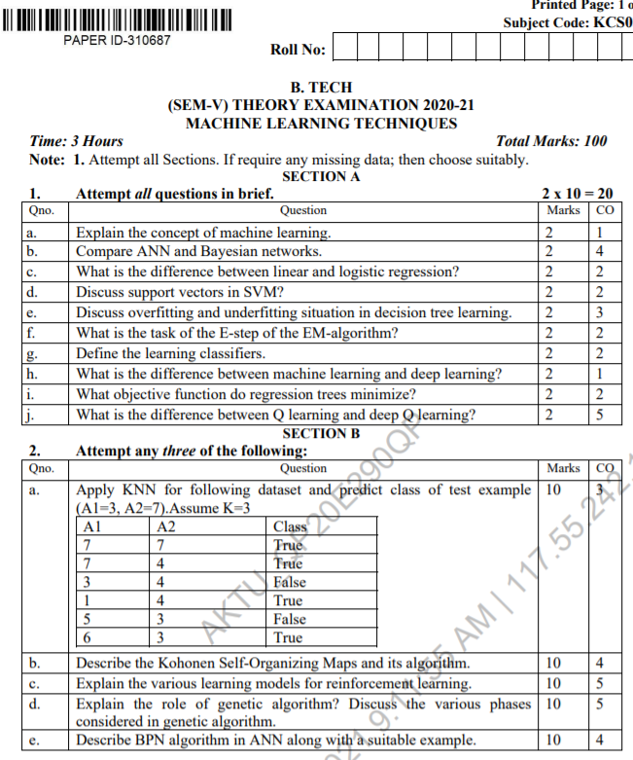
End Sem Question Papers Format

Slide 17
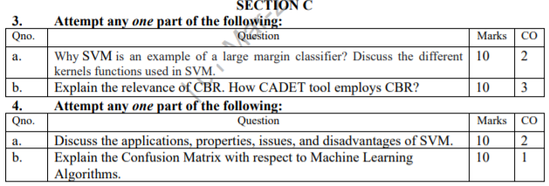
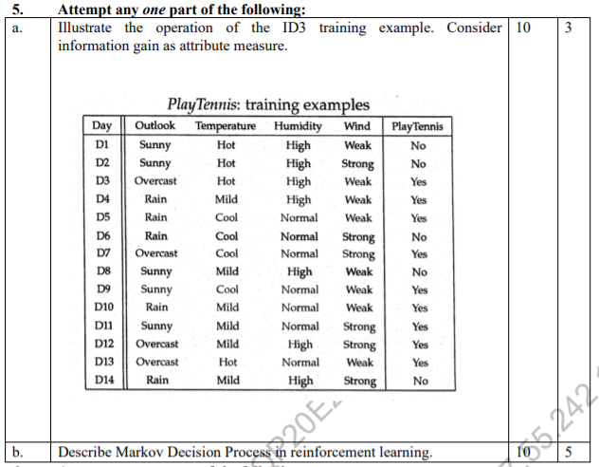
End Sem Question Papers Format

Slide 18
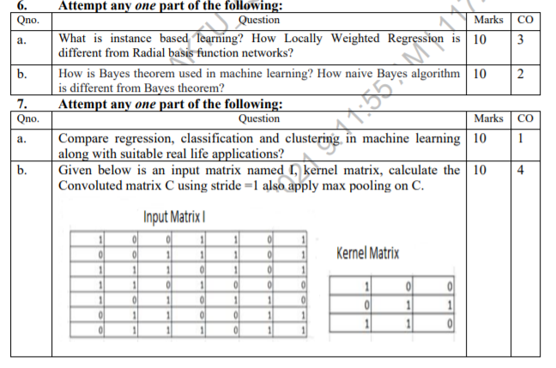
End Sem Question Papers Format

Slide 19
Prerequisite
To get started with Machine Learning you must be familiar with the following
concepts:
Algebra
variables, coefficients, and functions
linear equations such as y=b+w1x1+w2x2
logarithms, and logarithmic equations such as y=ln(1+ez)
sigmoid function
Linear algebra
tensor and tensor rank
matrix multiplication

Slide 20
Prerequisite
Trigonometry
Tan h (discussed as an activation function; no prior knowledge needed)
Calculus (optional, for advanced topics)
concept of a derivative (you won't have to actually calculate derivatives)
gradient or slope
partial derivatives (which are closely related to gradients)
chain rule (for a full understanding of the backpropagation algorithm for training neural networks)

Slide 21
Pre-requisite
Programming language:
It is essential to know programming languages like R and Python in order to implement the whole Machine Learning process. Python and R both provide in-built libraries that make it very easy to implement Machine Learning algorithms.

Slide 22
Unit Content
INTRODUCTION TO MACHINE LEARNING TECHNIQUES
Learning, Types of Learning,
Well defined learning problems,
Designing a Learning System,
History of ML,
Introduction of Machine Learning Approaches
Artificial Neural Network,
Clustering,
Reinforcement Learning,
Decision Tree Learning,
Bayesian networks,
Support Vector Machine,
Genetic Algorithm
Issues in Machine Learning and Data Science Vs Machine Learning;

Slide 23
Unit 1 Objective
Introduce the fundamentals of Well defined learning problems and Designing a Learning System
to study about basics of ML and issues related to ML.
learn about how Machine Learning Techniques used to solve concept based learning

Slide 24
Topic Objective/Outcomes
Learning, Types of Learning (CO1)
Well defined learning problems(CO1)
Designing a Learning System(CO1)
History of ML(CO1)
Introduction of Machine Learning Approaches (CO1)
Artificial Neural Network,
Clustering,
Reinforcement Learning,
Decision Tree Learning,
Bayesian networks,
Support Vector Machine,
Genetic Algorithm
Issues in Machine Learning and Data Science Vs Machine Learning (CO1)

Slide 25
Introduction
Machine learning (ML) is a field of computer science that gives computers the ability to automatically learn without being explicitly programmed.
• Learning from experience on data to make predictions.

Slide 26
Introduction(Learning)
Learning is the ability to improve one's behaviour based on experience.
Build computer systems that automatically improve with experience
What are the fundamental laws that govern all learning processes?
Machine Learning explores algorithms that can
learn from data / build a model from data
use the model for prediction, decision making or solving some tasks

Slide 27
Definition(ML)
Arthur Samuel (1959). Machine Learning: Field of study that gives computers the ability to learn without being explicitly programmed.
Tom Mitchell (1998) Well-posed Learning Problem: A computer program is said to learn from experience E with respect to some task T and some performance measure P, if its performance on T, as measured by P, improves with experience E.

Slide 28
Introduction
How to program computers to learn?
Learning: Improving automatically with experience
Example: Computers learning from medical records which treatments are most effective for new diseases
Added value: Better understanding of human learning abilities

Slide 29
Introduction(Learning)
“Learning is any process by which a system improves performance from experience.” - Herbert Simon
“Machine Learning is concerned with computer programs that automatically improve their performance through experience. “

Slide 30
Introduction(Learning)
A machine is said to be learning from past Experiences (data feed in) with respect to some class of Tasks, if it’s Performance in a given Task improves with the Experience
Learning is used when:
Human expertise does not exist (navigating on Mars),
Humans are unable to explain their expertise (speech recognition)
Solution changes in time (routing on a computer network)
Solution needs to be adapted to particular cases (user biometrics)

Slide 31
Introduction(Learning)
Example
Assume that a machine has to predict whether a customer will buy a specific product lets say “Antivirus” this year or not. The machine will do it by looking at the previous knowledge/past experiences i.e the data of products that the customer had bought every year and if he buys Antivirus every year, then there is a high probability that the customer is going to buy an antivirus this year as well. This is how machine learning works at the basic conceptual level

Slide 32
Why Machine Learning?
Develop systems that can automatically adapt and customize themselves to individual users.
Personalized news or mail filter
Discover new knowledge from large databases (data mining).
Market basket analysis (e.g. diapers and beer)
Ability to mimic human and replace certain monotonous tasks -which require some intelligence.
like recognizing handwritten characters

Slide 33
Why Machine Learning?
Develop systems that are too difficult/expensive to construct manually because they require specific detailed skills or knowledge tuned to a specific task (knowledge engineering bottleneck)

Slide 34
Why Machine Learning(now)?
Flood of available data (especially with the advent of the Internet)
Increasing computational power
Growing progress in available algorithms and theory developed by researchers
Increasing support from industries

Slide 35
Types of Machine Learning
The focus of this field is learning, that is, acquiring skills or knowledge from experience. Most commonly, this means synthesizing useful concepts from historical data.
Basis of classification of ML system
1. Three types of Learning are there :- on the basis of whether or not it needs
1.Supervised Learning
2.Unsupervised Learning
3. Semi-Supervised Learning
3.Reinforcement Learning

Slide 36
Types of Machine Learning
Supervised Learning
x, y (pre-classified training examples)
Given an observation x, what is the best label for y?
Unsupervised learning
X – Given a set of x’s, cluster or summarize them
Reinforcement Learning
Determine what to do based on rewards and punishments.

Slide 37
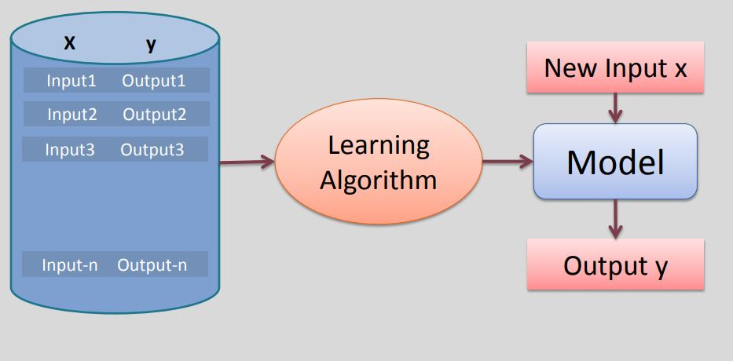
Supervised Learning:

Slide 38
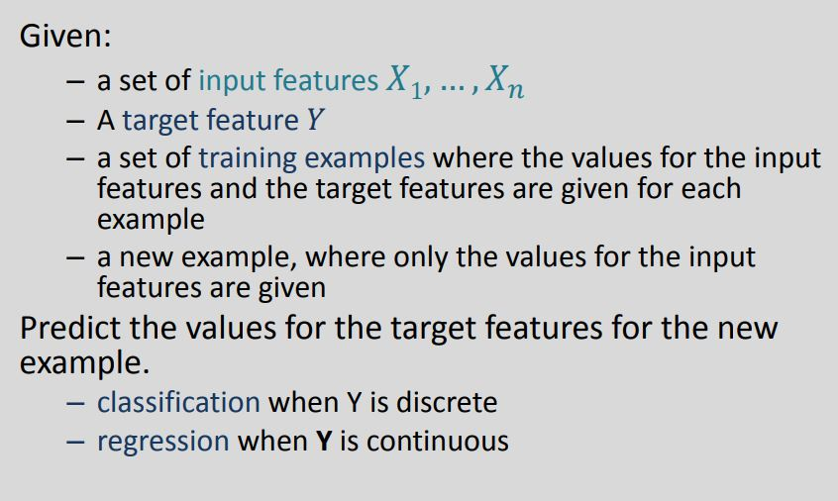
Supervised Learning:

Slide 39
Supervised Learning:
As shown in the previous example, we have initially taken some data and marked them as ‘Spam’ or ‘Not Spam’. This labeled data is used by the training supervised model, this data is used to train the model.
Once it is trained we can test our model by testing it with some test new mails and checking of the model is able to predict the right output.
Types of Supervised learning
Classification: A classification problem is when the output variable is a category, such as “red” or “blue” or “disease” and “no disease”.
ii. Regression: A regression problem is when the output variable is a real value, such as “dollars” or “weight”.

Slide 40
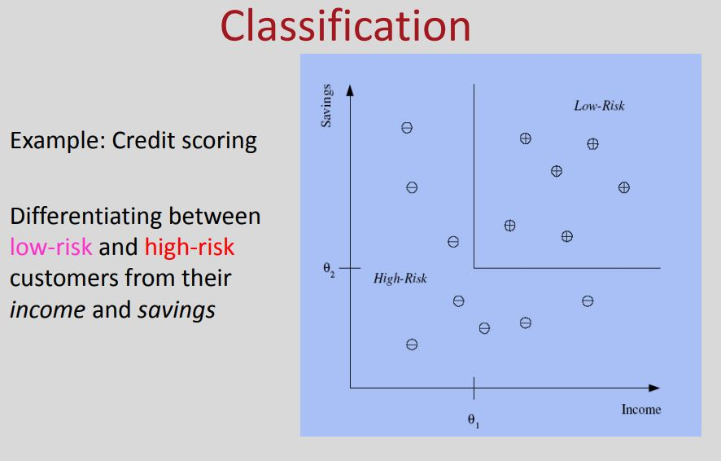
Supervised Learning:

Slide 41
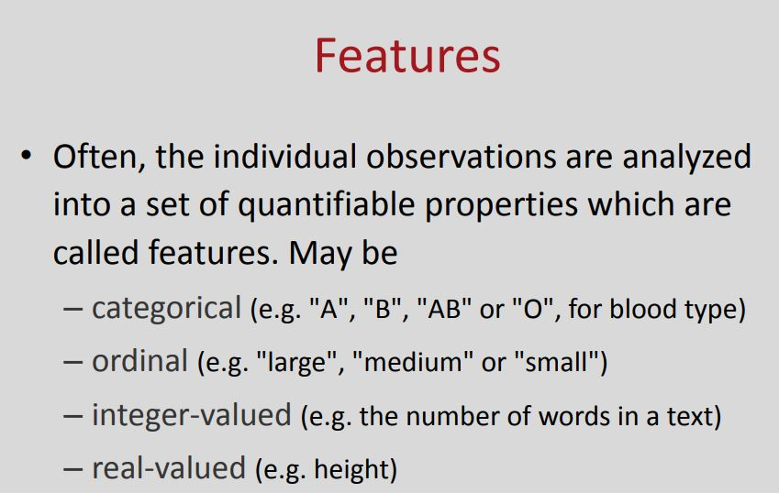
Supervised Learning:

Slide 42
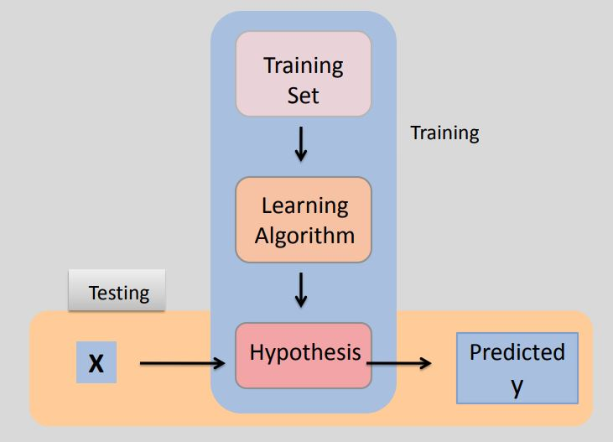
Supervised Learning:

Slide 43
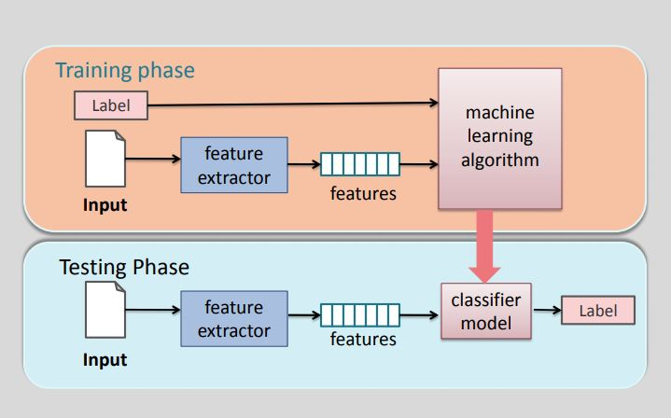
Supervised Learning:

Slide 44
Hypothesis Space:
Each setting of the parameters in the machine is a different hypothesis about the function that maps input vectors to output vectors.

Slide 45
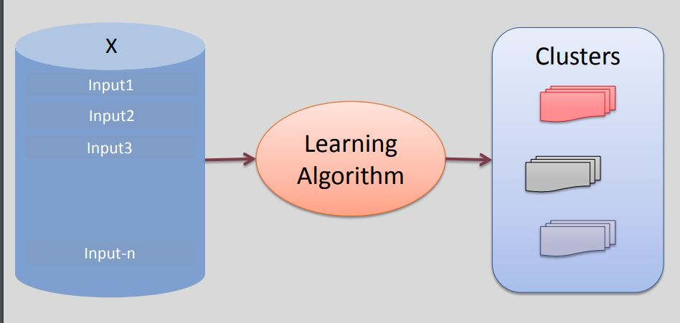
Unsupervised learning:

Slide 46
Unsupervised learning:
In unsupervised learning, an AI system is presented with unlabled, uncategorized data and the system’s algorithms act on the data without prior training.
The output is dependent upon the coded algorithms.
Subjecting a system to unsupervised learning is one way of testing AI.
In the example, we have given some characters to our model which are ‘Ducks’ and ‘Not Ducks’.

Slide 47
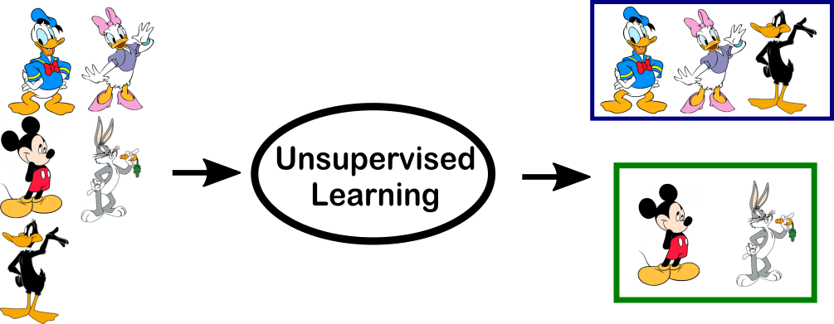
Unsupervised learning:

Slide 48
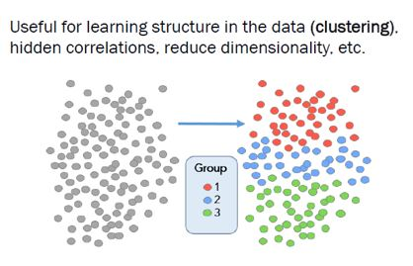
Unsupervised learning:

Slide 49
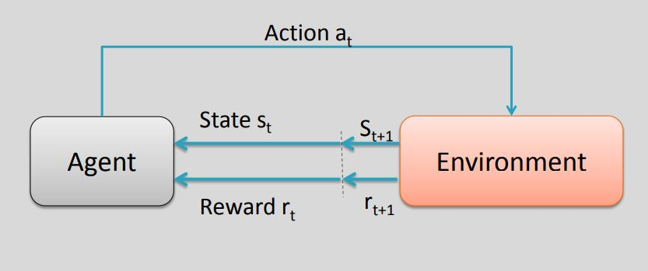
Reinforcement Learning:

Slide 50
Reinforcement Learning:
A reinforcement learning algorithm, or agent, learns by interacting with its environment.
The agent receives rewards by performing correctly and penalties for performing incorrectly.
The agent learns without intervention from a human by maximizing its reward and minimizing its penalty

Slide 51
Reinforcement Learning:
It is a type of dynamic programming that trains algorithms using a system of reward and punishment.
In the upcoming example, we can see that the agent is given 2 options i.e. a path with water or a path with fire.
A reinforcement algorithm works on reward a system i.e. if the agent uses the fire path then the rewards are subtracted and agent tries to learn that it should avoid the fire path.

Slide 52
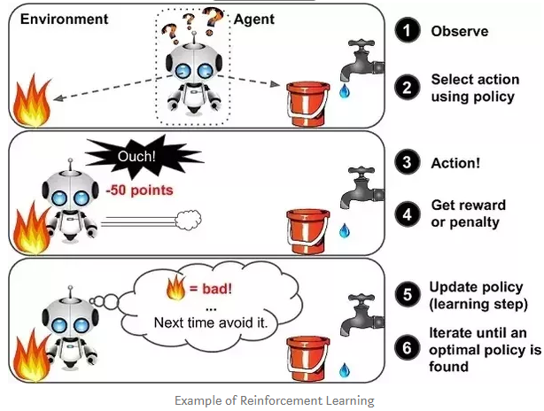
Reinforcement Learning:

Slide 53
Well-posed Learning Problems
Machine Learning Definition: A computer program is said to learn from experience E with respect to some class of tasks T and performance measure P, if its performance at tasks in T, as measured by P, improves with experience E.
Learning = Improving with experience at some task
Improve over task T,
With respect to performance measure, P
Based on experience, E.

Slide 54
Well-posed Learning Problems
For example, a computer program that learns to play checkers might improve its performance as measured by its ability to win at the class of tasks involving playing checkers games, through experience obtained by playing games against itself.

Slide 55
Well-posed Learning Problems
A checkers learning problem:
Task T: playing checkers
Performance measure P: percent of games won against opponents
Training experience E: playing practice games against itself

Slide 56
Well-posed Learning Problems
A handwriting recognition learning problem:
Task T: recognizing and classifying handwritten words within images
Performance measure P: percent of words correctly classified
Training experience E: a database of handwritten words with given classifications

Slide 57
Well-posed Learning Problems
In general, to have a well-defined learning problem
Learning to recognize spoken words
Learning to drive an autonomous vehicle.
Learning to classify new astronomical structures.
Learning to play world-class backgammon.

Slide 58
Well-posed Learning Problems
Some disciplines and examples of their influence on machine learning.
Artificial intelligence
Bayesian methods
Computational complexity theory
Control theory

Slide 59
Well-posed Learning Problems
Information theory
Philosophy
Psychology and neurobiology
Statistics

Slide 60
Advantage of ML
Learning and writing an algorithm
Its easy for human brain but it is tough for a machine. It takes some time and good amount of training data for machine to accurately classify objects
Implementation and automation
This is easy for a machine. Once learnt a machine can process one million images without any fatigue where as human brain can’t
That’s why ML with bigdata is a deadly combination

Slide 61
Machine Learning History
1950s:
Samuel's checker-playing program
1960s:
Neural Network: Rosenblatt’s perception
Pattern Recognition
Minsky & Papert prove limitations of Perceptron
1970s:
Symbolic concept introduction
Expert system and knowledge acquisition bottleneck
Quinlan’s ID3
Natural Language Processing(symbolic)

Slide 62
Machine Learning History
1980s:
Advanced decision tree and rule learning
Learning and planning and problem solving
Resurgence of neural network
Focus on experimental methodology

Slide 63
Machine Learning History
90’s ML and statistics:
Support vector machines
Data mining
Adaptive agent and web applications
Text learning
Reinforcement learning
Bayes Net learning

Slide 64
Machine Learning History
Popularity of this field in recent time and the reasons behind that
New software /algorithms
Neural networks
Deep learning
New hardware
GPU’s
Cloud Enabled
Availability of big data
2009: Google buildsSelf- driving car
2011: Watsons wins jeopardy
2014: Human vision surpassed by ML system

Slide 65
Designing a Learning System
let us consider designing a program to learn to play checkers, with the goal of entering it in the world checkers tournament
Choosing the Training Experience
Choose the target function
Choose a representation
Choose the parameter fitting algorithm
Evaluate the entire system

Slide 66
Designing a Learning System
Choosing the Training Experience:
different learning paradigms: reinforcement learning, supervised learning, unsupervised learning
different availability of data: online/offline examples

Slide 67
Designing a Learning System
2. Choose the target function
make it as easy as possibly
integrate all prior information
learn only the aspects which you have to learn

Slide 68
Designing a Learning System
Choose a representation of the target function
representation of the input data:
integrate all relevant features -> make it easy
but not more than necessary -> curse of dimensionality
representation of the function:
different types of functions: classification, regression, density estimation, novelty detection, visualization, ...
different models: symbolic (logical rules, decision tree, prolog program, ...), subsymbolic (neural network, statistical estimator, ...), parameterized, lazy model, ...

Slide 69
Designing a Learning System
Estimate the parameters
optimize some error/objective on the given data
linear/quadratic optimization
gradient descent
greedy algorithm, heuristics
discrete optimization methods such as genetic algorithms
statistical methods such as EM

Slide 70
Designing a Learning System
Evaluation
does the system behave well in practice
generalization to data not used for training
make sure the underlying regularity and not only the given (finite set of) data is learned

Slide 71
Designing a Learning System
In order to complete the design of the learning system, we must now choose
the exact type of knowledge to be, learned
a representation for this target knowledge
a learning mechanism

Slide 72
Designing a Learning System
Choosing the Target Function
if b is a final board state that is won, then V(b) = 100
if b is a final board state that is lost, then V(b) = -100
if b is a final board state that is drawn, then V(b) = 0
if b is a not a final state in the game, then V(b) = V(bl), where b' is the best final board state that can be achieved starting from b and playing optimally until the end of the game

Slide 73
Designing a Learning System
Choosing the Target Function
if b is a final board state that is won, then V(b) = 100
if b is a final board state that is lost, then V(b) = -100
if b is a final board state that is drawn, then V(b) = 0
if b is a not a final state in the game, then V(b) = V(bl), where b' is the best final board state that can be achieved starting from b and playing optimally until the end of the game

Slide 74
Designing a Learning System
Choosing a Representation for the Target Function
xl: the number of black pieces on the board
x2: the number of red pieces on the board
x3: the number of black kings on the board
x4: the number of red kings on the board
x5: the number of black pieces threatened by red (i.e., which can be captured on red's next turn)
X6: the number of red pieces threatened by black
V’(b) = w0+w1x1+w2x2+w3x3+w4x4+w5x5+w6x6
where wo through W6 are numerical coefficients, or weights, to be chosen by the learning algorithm

Slide 75
Designing a Learning System
Partial design of a checkers learning program:
Task T: playing checkers
Performance measure P: percent of games won in the world tournament
Training experience E: games played against itself
Target function: V:Board → y
Target function representation
V’(b) = w0+w1x1+w2x2+w3x3+w4x4+w5x5+w6x6

Slide 76
Designing a Learning System
Choosing a Function Approximation Algorithm
Estimating Training Values
Adjusting The Weights
LMS weight update rule.
The Final Design
Performance System
Critic
Generalizer
Experiment Generator

Slide 77
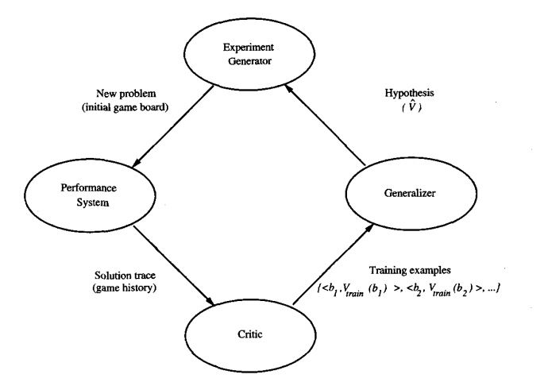
Designing a Learning System
Figure 1.1: Final design of the checkers learning program.

Slide 78
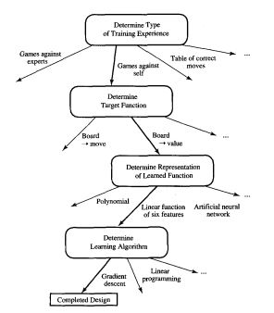
Designing a Learning System
Figure 1.2: Summary of choices in designing the checkers learning program

Slide 79
Issues in Machine Learning
Data Quality:
ML is only as good as the data you provide it and you need a lot of data. Accuracy of ML is driven by the quality of the data.
Transparency
It is often very difficult to make definitive statements on how well a model is going to generalize in new environments.
Manpower
Having data and being able to use it so does not introduce bias into the model. How organizations change how they think about software development and how they collect and use data. Make sure they have enough skillsets in the organization.

Slide 80
Issues in Machine Learning
What algorithms exist for learning general target functions from specific training examples? In what settings will particular algorithms converge to the desired function, given sufficient training data? Which algorithms perform best for which types of problems and representations?
How much training data is sufficient? What general bounds can be found to relate the confidence in learned hypotheses to the amount of training experience and the character of the learner's hypothesis space?

Slide 81
Issues in Machine Learning
When and how can prior knowledge held by the learner guide the process of generalizing from examples? Can prior knowledge be helpful even when it is only approximately correct?
What is the best strategy for choosing a useful next training experience, and how does the choice of this strategy alter the complexity of the learning problem?
What is the best way to reduce the learning task to one or more function approximation problems? Put another way, what specific functions should the system attempt to learn? Can this process itself be automated?

Slide 82
Issues in Machine Learning
How can the learner automatically alter its representation to improve its ability to represent and learn the target function?

Slide 83
Data Science Vs Machine Learning
Data science is a concept used to tackle big data and includes data cleansing, preparation, and analysis.
A data scientist gathers data from multiple sources and applies machine learning, predictive analytics, and sentiment analysis to extract critical information from the collected data sets. They understand data from a business point of view and can provide accurate predictions and insights that can be used to power critical business decisions.

Slide 84
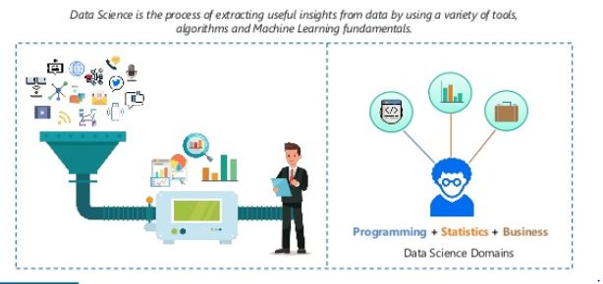
Data Science Vs Machine Learning

Slide 85
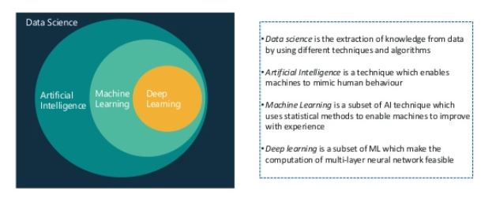
Data Science Vs Machine Learning

Slide 86
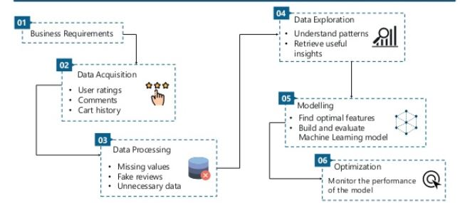
Data Science Vs Machine Learning

Slide 87
Data Science Vs Machine Learning
Machine learning :can be defined as the practice of using algorithms to extract data, learn from it, and then forecast future trends for that topic.

Slide 88
Data Science Vs Machine Learning(Case Study)
Case Study: How Would the Three Be Used Together?
Suppose we were building a self-driving car, and were working on the specific problem of stopping at stop signs. We would need skills drawn from all three of these fields.
ML The car has to recognize a stop sign using its cameras. We construct a dataset of millions of photos of street side objects, and train an algorithm to predict which have stop signs in them.
AI: Once our car can recognize stop signs, it needs to decide when to take the action of applying the brakes. It’s dangerous to apply them too early or too late, and we need it to handle varying road conditions (for example, to recognize on a slippery road that it is not slowing down quickly enough), which is a problem of control theory.

Slide 89
Data Science Vs Machine Learning
Data science: In street tests we find that the car’s performance isn’t good enough, with some false negatives in which it drives right by a stop sign. After analysing the street test data, we gain the insight that the rate of false negatives depends on the time of day: it is more likely to miss a stop sign before sunrise or after sunset. We realize that most of our training data included only objects in full daylight, so we construct a better dataset including night time images and go back to the machine learning step.

Slide 90
Introduction of Machine Learning Approaches
Decision Tree Learning:
Decision tree belongs to the deterministic family of classifier and is a model based techniques.
The most common implementation of decision tree algo uses a binary tree structure for classification.
It is in the nature of the decision tree algorithm to overfit the training data
DT pruning: Experimenting with the depth of the tree to avoid overfitting is know as decision tree pruning

Slide 91
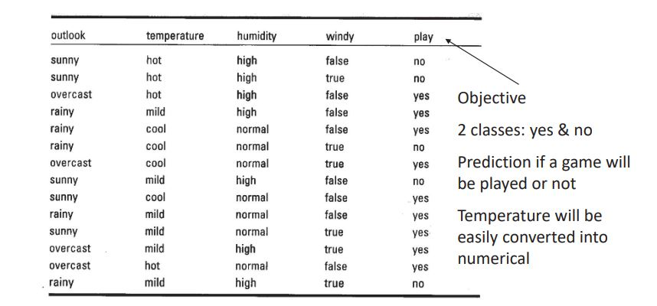
Introduction of Machine Learning Approaches

Slide 92
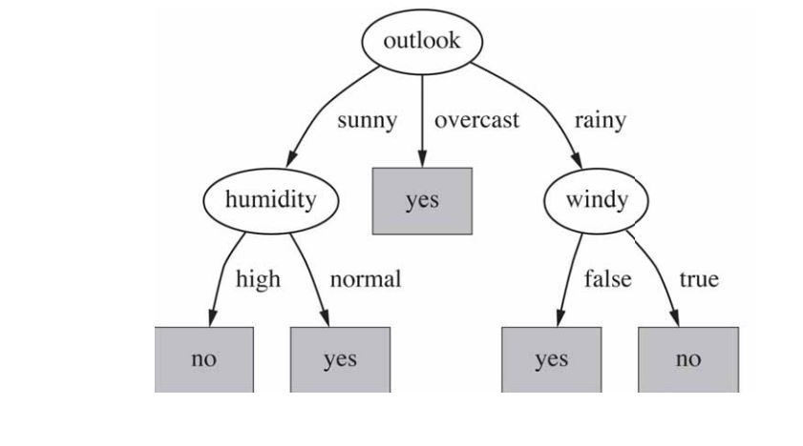
Introduction of Machine Learning Approaches

Slide 93
Introduction of Machine Learning Approaches
Now the question arise??
Q1: How has the Decision tree Algorithm selected the attribute ‘k’?
Or
Q2: How has the decision tree algorithm selected the threshold ‘k’?
Answer is :with the help of ‘Gini’ and ‘Entropy’ with minimum value
Que: how has the decision tree algorithm divided the depth?
Answer : with the help of parameter setting max-depth = ‘2’ 0r by using ‘Grid Search’

Slide 94
Introduction of Machine Learning Approaches
Genetic algorithms
Genetic algorithms are stochastic search algorithms which act on a population of possible solutions.
They are loosely based on the mechanics of population genetics and selection.
The potential solutions are encoded as ‘genes’ — strings of characters from some alphabet.

Slide 95
Introduction of Machine Learning Approaches
New solutions can be produced by ‘mutating’ members of the current population, and by ‘mating’ two solutions together to form a new solution.
The better solutions are selected to breed and mutate and the worse ones are discarded.

Slide 96
Introduction of Machine Learning Approaches
Reinforcement Learning: A reinforcement learning algorithm, or agent, learns by interacting with its environment.
Reinforcement learning is a goal-driven, highly adaptive machine learning technique in the field of artificial intelligence , in which there are two basic elements: state and action
Performing an action in a certain state is a strategy. The learner must constantly explore to generate an optimal strategy.

Slide 97
Introduction of Machine Learning Approaches
Different from supervised and unsupervised learning, it regards learning as a process of interaction between agents and the environment through exploration and evaluation.
The agent selects an action to be applied to the environment by sensing the current state of the environment.
After the environment accepts the action, the state changes, and a reward is given to the agent.

Slide 98
Introduction of Machine Learning Approaches
According to the new state of the environment, the agent continues to select the next action, and this is repeated until it reaches the terminated state.
The goal of reinforcement learning is to maximize the accumulated rewards by adjusting strategies.

Slide 99
Introduction of Machine Learning Approaches
Learning Models of Reinforcement
There are two important learning models in reinforcement learning:
Markov Decision Process
Q learning

Slide 100
Introduction of Machine Learning Approaches

Slide 101
Introduction of Machine Learning Approaches
Support Vector Machine: SVM derived from ‘Maximal Margin Classifier’ only suitable for binary Classification.
Maximal Margin classifier:
Dimension: (p=1) ,(p=2)
Hyperplane: (p-1)= 0 ,(p-1)=1,
Support vector Machine works with Linearly Separable data
In 1990 SVM works on in replacement of neural network as powerful Algorithm. but today it works on simple data

Slide 102
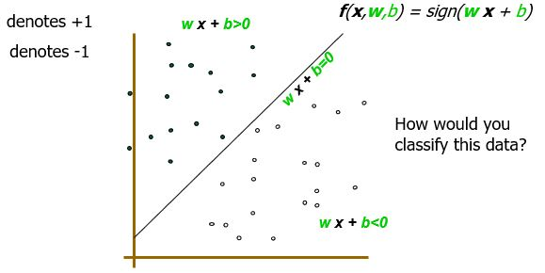
Introduction of Machine Learning Approaches

Slide 103
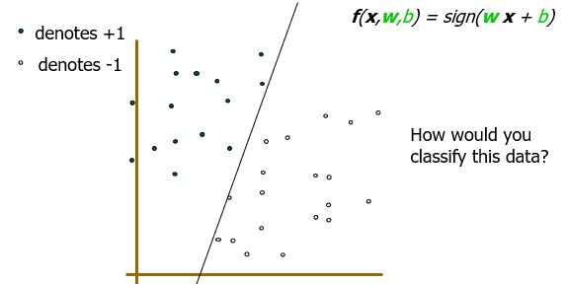
Introduction of Machine Learning Approaches

Slide 104
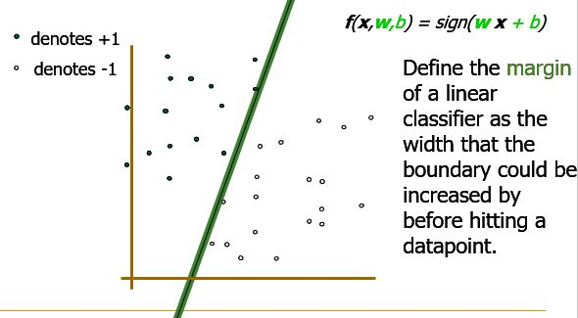
Introduction of Machine Learning Approaches

Slide 105
Introduction of Machine Learning Approaches
Clustering:
Process of grouping similar items together
Clusters should be very similar to each other but…
Should be very different from the objects of other clusters/ other clusters
We can say that intra-cluster similarity between objects is high and inter-cluster similarity is low
Important human activity --- used from early childhood in distinguishing between different items such as cars and cats, animals and plants etc

Slide 106
Introduction of Machine Learning Approaches
Assumes documents are real-valued vectors.
Clusters based on centroids (aka the centre of gravity or mean) of points in a cluster, c:
Reassignment of instances to clusters is based on distance to the current cluster centroids.
(Or one can equivalently phrase it in terms of similarities)
Select K random docs {s1, s2,… sK} as seeds.
Until clustering converges (or other stopping criterion):
For each doc di:
Assign di to the cluster cj such that dist(xi, sj) is minimal.
(Next, update the seeds to the centroid of each cluster) For each cluster cj

Slide 107
Introduction of Machine Learning Approaches
Simplest case: one numeric attribute A
Distance(X,Y) = A(X) – A(Y)
Several numeric attributes:
Distance(X,Y) = Euclidean distance between X,Y
Are all attributes equally important?
Weighting the attributes might be necessary

Slide 108
Introduction of Machine Learning Approaches
Simple Clustering: K-means
Works with numeric data only
Pick a number (K) of cluster centers (at random)
Assign every item to its nearest cluster center (e.g. using Euclidean distance)
Move each cluster center to the mean of its assigned items
Repeat steps 2,3 until convergence (change in cluster assignments less than a threshold)

Slide 109
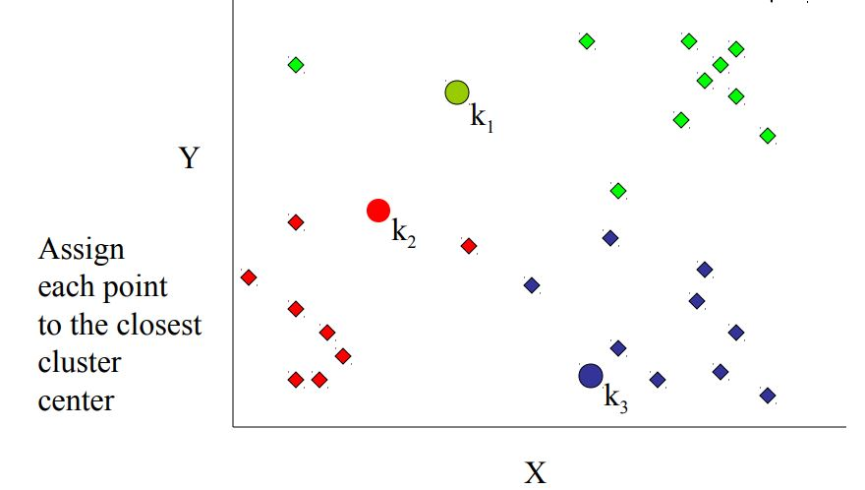
Introduction of Machine Learning Approaches
Step 2

Slide 110
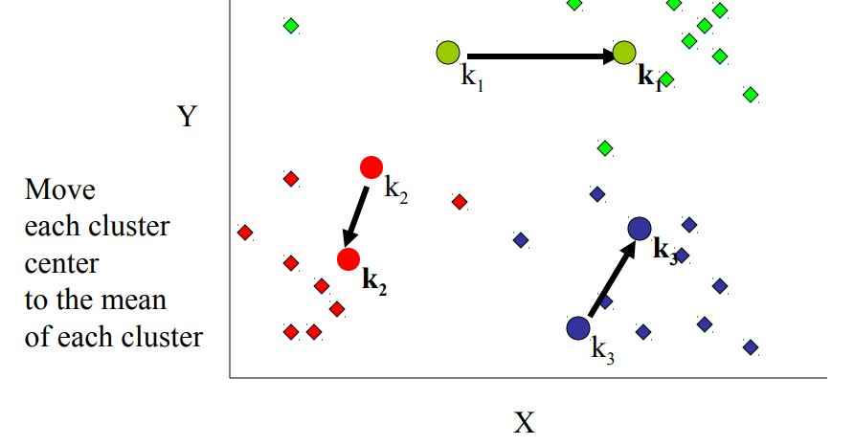
Introduction of Machine Learning Approaches
Step 3

Slide 111
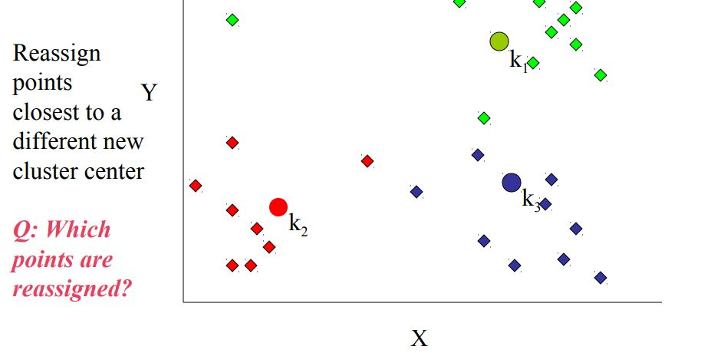
Introduction of Machine Learning Approaches
Step 4

Slide 112
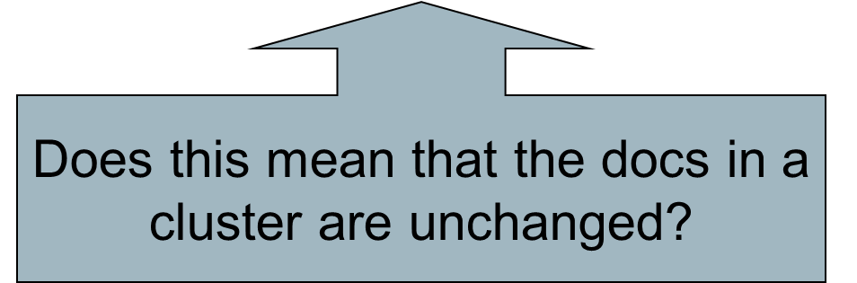
Introduction of Machine Learning Approaches
Termination conditions
Several possibilities, e.g.,
A fixed number of iterations.
Doc partition unchanged.
Centroid positions don’t change.

Slide 113
Introduction of Machine Learning Approaches
How Many Clusters?
Number of clusters K is given
Partition n docs into predetermined number of clusters
Finding the “right” number of clusters is part of the problem
Given docs, partition into an “appropriate” number of subsets.
E.g., for query results - ideal value of K not known up front - though UI may impose limits.
Can usually take an algorithm for one flavor and convert to the other.

Slide 114
Introduction of Machine Learning Approaches
Hierarchical Clustering
Build a tree-based hierarchical taxonomy (dendrogram) from a set of documents.
One approach: recursive application of a partitional clustering algorithm
animal
vertebrate
invertebrate
fish reptile amphib. mammal worm insect crustacean

Slide 115
Introduction of Machine Learning Approaches
Starts with each doc in a separate cluster
then repeatedly joins the closest pair of clusters, until there is only one cluster.
The history of merging forms a binary tree or hierarchy.

Slide 116
Introduction of Machine Learning Approaches
Many variants to defining closest pair of clusters:
Single-link
Similarity of the most cosine-similar (single-link)
Complete-link
Similarity of the “furthest” points, the least cosine-similar
Centroid
Clusters whose centroids (centres of gravity) are the most cosine-similar
Average-link
Average cosine between pairs of elements

Slide 117
Faculty Video Links, Youtube & NPTEL Video Links and Online Courses Details
Youtube /other Video Links
https://www.youtube.com/watch?v=-bVg1S6Wp9A
https://www.youtube.com/watch?v=RAR1i6MNVp8&list=PLmG0rt4jIn-ysN0G4MZoFLftBzHAWGyoZ
https://www.youtube.com/watch?v=hG30vxQzyJ4&list=PLmG0rt4jIn-ysN0G4MZoFLftBzHAWGyoZ&index=3
https://www.youtube.com/watch?v=EVNMDEjULuQ&list=PLmG0rt4jIn-ysN0G4MZoFLftBzHAWGyoZ&index=7
https://www.youtube.com/watch?v=q25Pijh0W14&list=PLmG0rt4jIn-ysN0G4MZoFLftBzHAWGyoZ&index=8

Slide 118
Daily Quiz
Q1: Which of the following is an example of a deterministic algorithm?
A. PCA
B) K-Means
C) None of the above
Q2: Regarding bias and variance, which of the follwing statements are true? (Here ‘high’ and ‘low’ are
relative to the ideal model.)
(a) Models which overfit have a high bias.
(b) Models which overfit have a low bias.
(c) Models which underfit have a high variance.
(d) Models which underfit have a low variance.

Slide 119
Daily Quiz
Q3. . Consider a binary classification problem. Suppose I have trained a model on a linearly separable training set, and now I get a new labelled data point which is correctly classified by the model, and far
away from the decision boundary. If I now add this new point to my earlier training set and re-train,in which cases is the learnt decision boundary likely to change?
A. When my model is a perceptron.
(b) When my model is logistic regression.
(c) When my model is an SVM.
(d) When my model is Gaussian discriminant analysis.

Slide 120
Daily Quiz
Q4. Suppose your model is overfitting. Which of the following is NOT a valid way to try and reduce the
overfitting?
(a) Increase the amount of training data.
(b) Improve the optimisation algorithm being used for error minimisation.
(c) Decrease the model complexity.
(d) Reduce the noise in the training data.
Q5. . Choose the options that are correct regarding machine learning (ML) and
artificial intelligence (AI),
(A) ML is an alternate way of programming intelligent machines.
(B) ML and AI have very different goals.
(C) ML is a set of techniques that turns a dataset into a software.
(D) AI is a software that can emulate the human mind.

Slide 121
Daily Quiz
Q6. Which combines inductive methods with the power of first-order representations?
a) Inductive programming
b) Logic programming
c) Inductive logic programming
d) Lisp programming
Q7Which method can’t be used for expressing relational knowledge?
a) Literal system
b) Variable-based system
c) Attribute-based system
d) None of the mentioned

Slide 122
Daily Quiz
Q8.what is the purpose of restricting hypothesis space in Machine Learning?
a) Can be easier to search
b) May avoid overfit since they are simple
c) Both of the above
d) None of the above
Q10. statement whether the statement are true or false
Statement A: when the hypothesis space is richer, overfitting is more likely.
Statement B: when the feature space is larger, overfitting is more likely.
false, False
True, True
True , False
False ,True

Slide 123
Daily Quiz
Q1. Which combines inductive methods with the power of first-order representations?
a) Inductive programming
b) Logic programming
c) Inductive logic programming
d) Lisp programming
Q2. Which method can’t be used for expressing relational knowledge?
a) Literal system
b) Variable-based system
c) Attribute-based system
d) None of the mentioned

Slide 124
Daily Quiz
Q3. [True or False] Log Loss evaluation metric can have negative values.
A) TRUE
B) FALSE
Q4. Gradient of a continuous and differentiable function
(A) is zero at a minimum
(B) is non-zero at a maximum
(C) is zero at a saddle point
(D) decreases as you get closer to the minimum

Slide 125
MCQ s
Q1. regarding bias and variance, which of the following statement are true?
A. Models which overfit are more likely to have high bias
B. Models which overfit are more likely to have low bias
C. Models which overfit are more likely to have high variance
D. Models which overfit are more likely to have low variance
Q2.you are given review of few movies marked as positive, negative or neutral, Classifying review of a new movie is an example of:
A. Supervised learning
B. Un-Supervised learning
C. Reinforcement learning
D. semi-Supervised learning

Slide 126
MCQ s
Q3. Which of the following options is/are true for K-fold cross-validation?
Increase in K will result in higher time required to cross validate the result.
Higher values of K will result in higher confidence on the cross-validation result as compared to lower value of K.
If K=N, then it is called Leave one out cross validation, where N is the number of observations.
A) 1 and 2
B) 2 and 3
C) 1 and 3
D) 1,2 and 3

Slide 127
MCQ s
Q4. A feature F1 can take certain value: A, B, C, D, E, & F and represents grade of students from a college.
1) Which of the following statement is true in following case?
A) Feature F1 is an example of nominal variable.
B) Feature F1 is an example of ordinal variable.
C) It doesn’t belong to any of the above category.
D) Both of these
Q5. Mapping technique in load balancing that distribute the tasks among processes prior to the execution of the algorithm.
A. Static Mapping
B. Dynamic Mapping
C. Serial Mapping
D. Parallel Mapping

Slide 128
MCQ s
Q6. : [True or False] Log Loss evaluation metric can have negative values.
A) TRUE
B) FALSE
Q7. Gradient of a continuous and differentiable function
(A) is zero at a minimum
(B) is non-zero at a maximum
(C) is zero at a saddle point
(D) decreases as you get closer to the minimum

Slide 129
MCQ s
Q8. Computational complexity of Gradient descent is,
(A) linear in D
(B) linear in N
(C) polynomial in D
(D) dependent on the number of iterations
Q9. Adding more basis functions in a linear model... (pick the most probably
option)
(A) Decreases model bias
(B) Decreases estimation bias
(C) Decreases variance
(D) Doesn’t affect bias and variance

Slide 130
Weekly Assignment
Q1. Explain applications and challenges of Machine Learning. CO1
Q2. What is Overfitting, and How Can You Avoid It? CO1
Q3. Explain well posed learning system with example. CO1
Q4. What is the concept learning task? explain in details CO1

Slide 131
Weekly Assignment
Q5. What is the Candidate Elimination Algorithm? Explain following CO1
(a) Consistency Vs. Coverage CO1
(b) Version Spaces CO1
Q6. explain the Three Learners with Different Biases.
CO1
Q7. Write an algorithm for the Candidate Elimination.

Slide 132
Weekly Assignment
Q8. Explain The Candidate Elimination Algorithm with positive and negative examples. CO1
Q9. describe The Find-S Algorithm with example.
CO1
Q10. Differentiate between following: CO1
a) Supervised Learning and Un-Supervised Learning
b) Bias and Variance

Slide 133
Old Question Papers

Slide 134
Old Question Papers

Slide 135
Old Question Papers

Slide 136
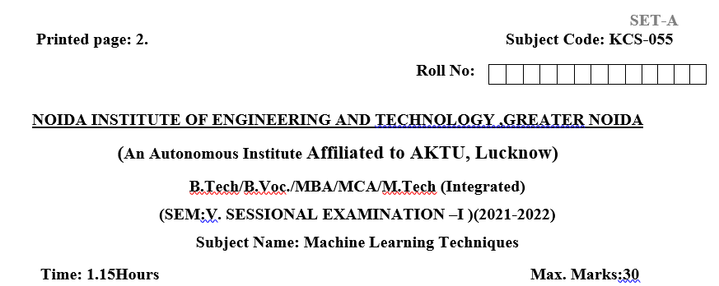
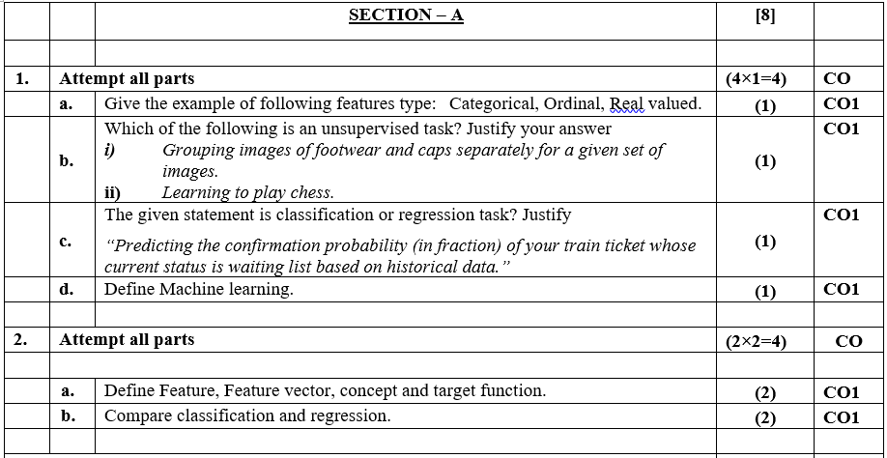
Sessional Question Papers

Slide 137
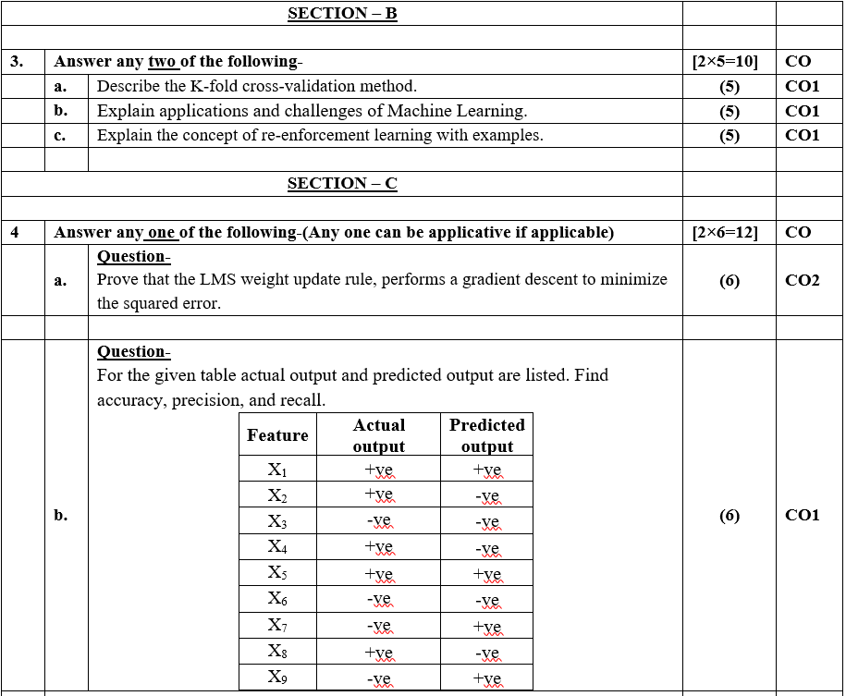
Sessional Question Papers

Slide 138
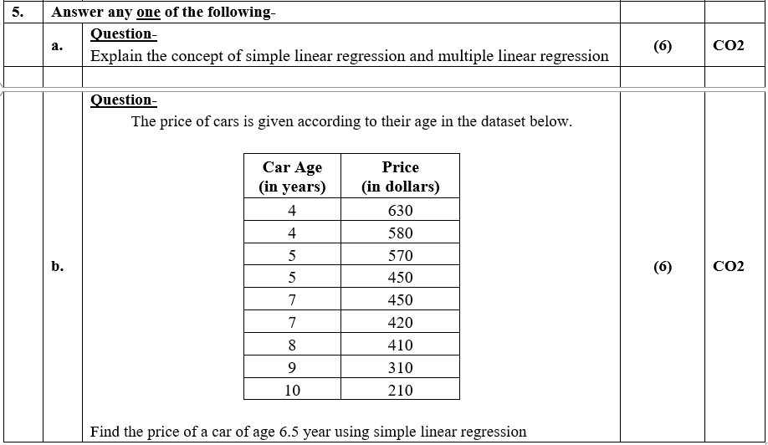
Sessional Question Papers

Slide 139
Expected Question Paper
List out the types of machine learning.
Define perceptron.
What is a spline ?
State the applications of radial basis function network.
Write the concept behind ensemble learning.
Distinguish between classification and regression.
What is dimensionality reduction ?
Define evolutionary computation.
What is sampling ?
Define Bayesian network.

Slide 140
Expected Question Paper
11. a).Describe the perspective and issues in machine learning.
b) Discuss linear regression with an example.
12 .a) Explain multi-layer perceptron model with a neat diagram.
b) Describe the working behavior of support vector machine with diagrams.
13. a) Elaborate on Classification and Regression Trees (CART) with examples.
b) Summarize K-means algorithm and group the points (1, 0, 1), (1, 1, 0), (0, 0, 1)and (1, 1, 1) using K-means algorithm.

Slide 141
Expected Question Paper
14. a) Describe how principal component analysis is caried out to reduce dimensionality of data sets.
b) i) Write short notes on reinforcement learning.
ii) What is meant by isomap ? Give its significance in machine learning.
15. a) Discuss Markov Chain Monte Carlo Methods in detail.
b) Explain hidden Markov models in detail.

Slide 142
Expected Question Paper
16. a) Choose two destination with different routes connecting them. Apply genetic algorithm to find the optional path based on distance.
(oR)
b) Use decision tree to classify the students in a class based on their academic performance

Slide 143
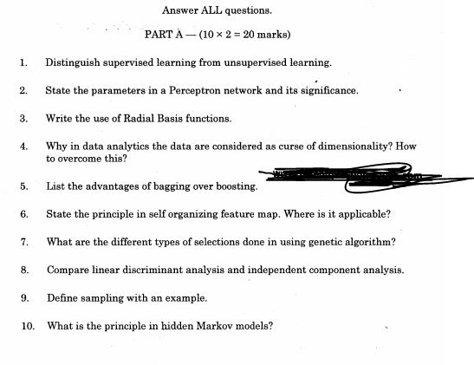
Expected Questions for University Exam

Slide 144
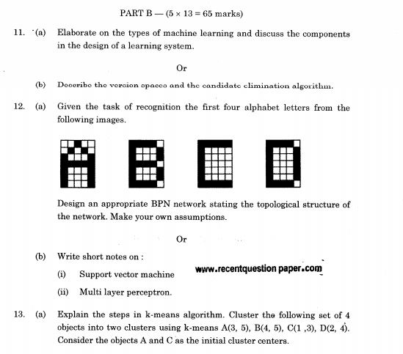
Expected Questions for University Exam

Slide 145
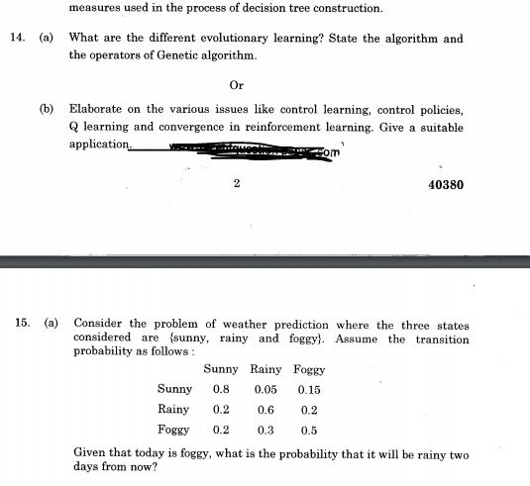
Expected Questions for University Exam

Slide 146
Recap
1. Concept learning as search through H
2. General-to-specific ordering over H
3. Version space candidate elimination algorithm
4. S and G boundaries characterize learner’s uncertainty
5. Learner can generate useful queries
6. Inductive leaps possible only if learner is biased
7. Inductive learners can be modelled by equivalent deductive systems

Slide 147
Glossary Questions
1. Choose correct option
i. Supervised Learning ii. Unsupervised Learning iii. Reinforcement Learning
a. Game AI Skill Aquisition, and Robot Navigation are applications of …….
b. Targetted marketing, Recommended Systems are applications of -------------.
c. Fraud Detection, Image Classification are applications of -------------.
2. Choose correct option
i) Existing (ii) discrete (iii) Version Space (iv) continuous
The Candidate-Elimination Algorithm represents the---------
Inductive learning takes examples and generalizes rather than starting with ----------------------
Classification problem have------levels
Regression problem have---------levels

Slide 148
Summary
Concept learning can be cast as a problem of searching through a large predefined space of potential hypotheses.
General-to-specific partial ordering of hypotheses provides a useful structure for search.
Find-S algorithm performs specific-to general search to find the most specific hypothesis.
Candidate-Elimination algorithm computes version space by incrementally computing the sets of maximally specific (S) and maximally general (G) hypotheses.

Slide 149
Summary
S and G delimit the entire set of hypotheses consistent with the data.
Version spaces and Candidate-Elimination algorithm provide a useful conceptual framework for studying concept learning.
Candidate-Elimination algorithm is not robust to noisy data or to situations where the unknown target concept is not expressible in the provided hypothesis space.
Inductive bias in Candidate-Elimination algorithm is that target concept exists in H.

Slide 150
References
https://www.studytonight.com/post/leetcode-solution-best-time-to-buy-and-sell-stock-problem
https://www.studytonight.com/post/designing-a-learning-system-the-first-step-to-machine-learning
https://dzone.com/articles/issues-with-machine-learning-in-software-developme(issues in Ml)
https://www.slideshare.net/ParthaSarathiKar3/practical-issues-in-machine-learning-75693480(issues in ML)

Slide 151
References
http://staff.fit.ac.cy/com.ph/ml/ML_Lecture_2.pdf(comlete unit 1 content)
https://bi.snu.ac.kr/Courses/g-ai04_2/ML02.pdf(complete 1 unit)
https://slideplayer.com/slide/4245918/(best slide unit 1 content find s or hypothesis)

Slide 152
Thank You

